Slide 1
Extracting compact knowledge from massive data
Dejiao Zhang
Electrical Engineering and Computer Science
University of Michigan, Ann Arbor

Slide 2
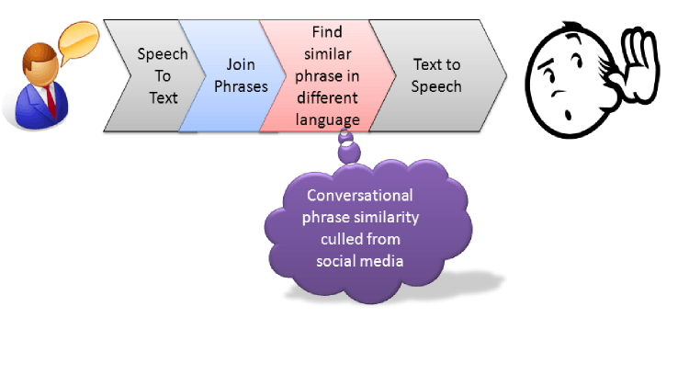
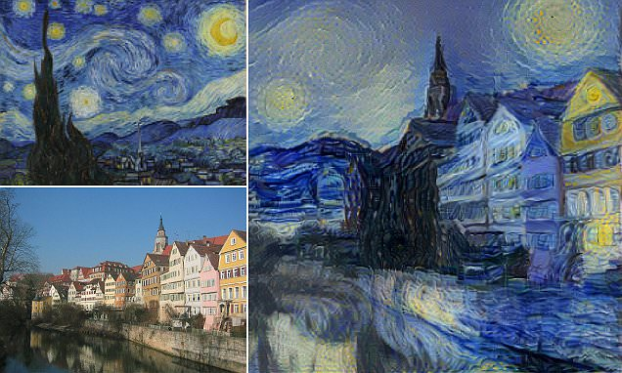
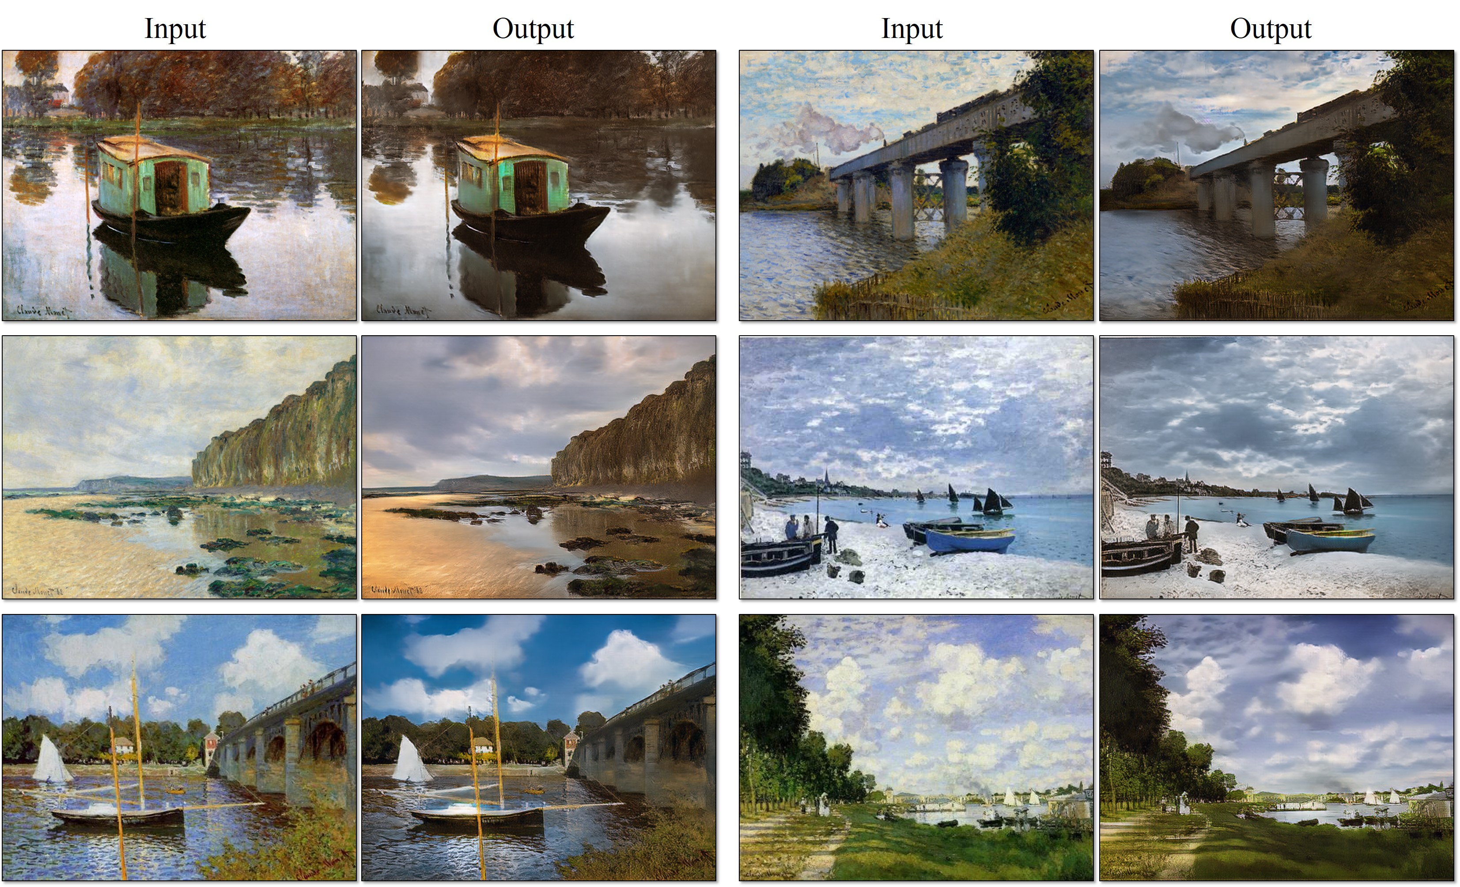
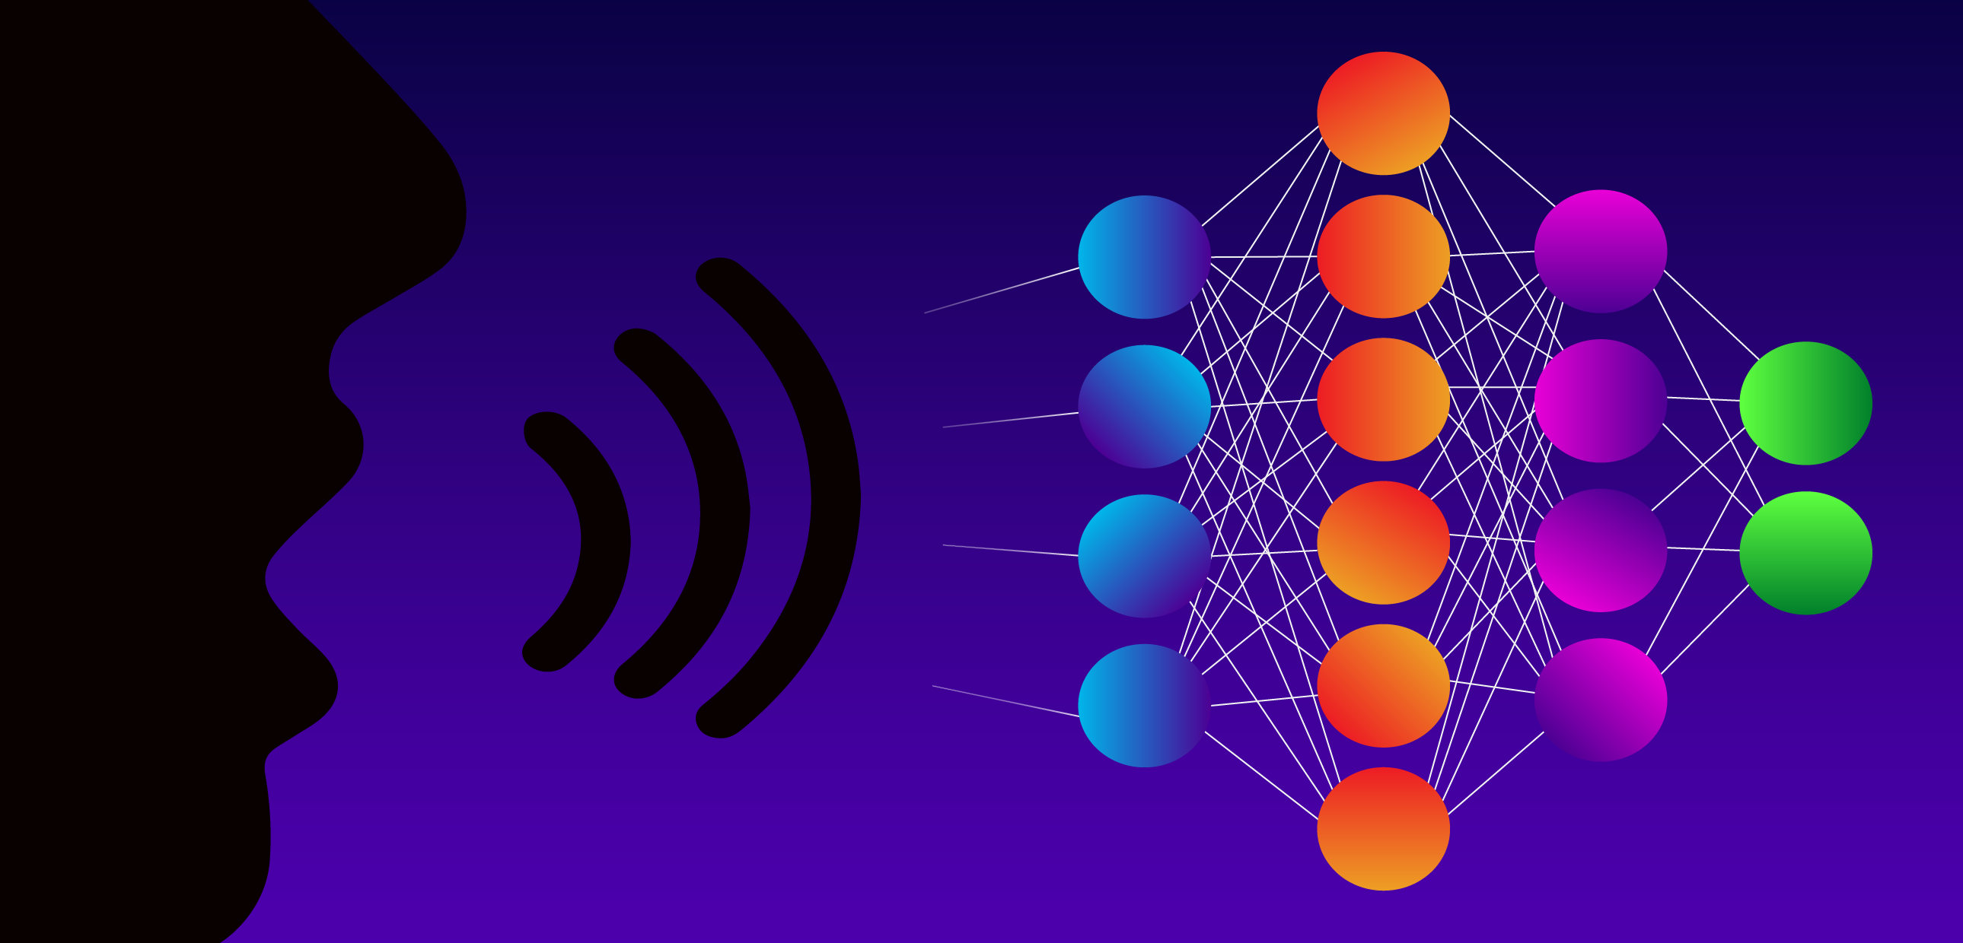

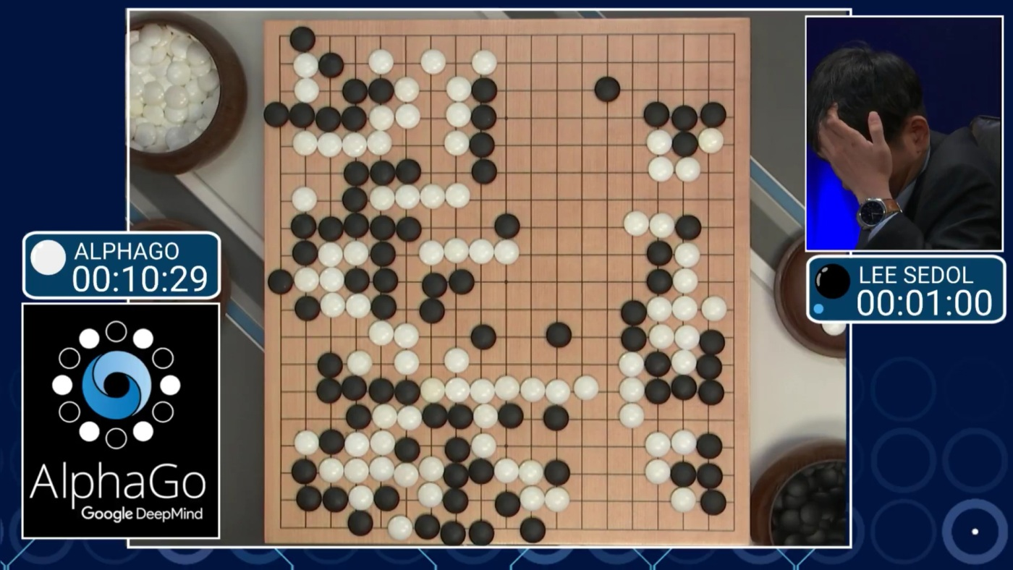
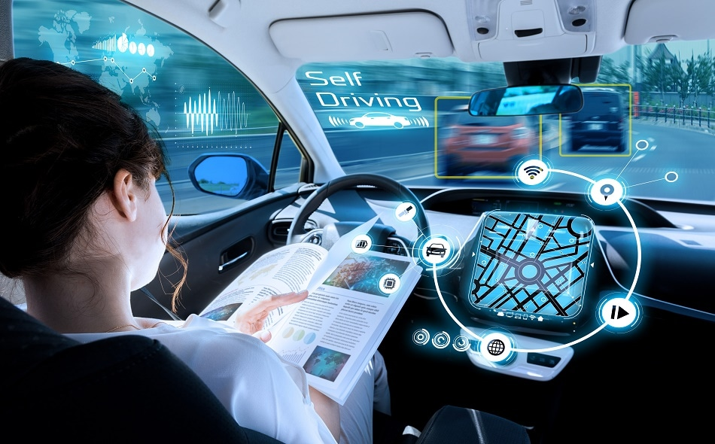
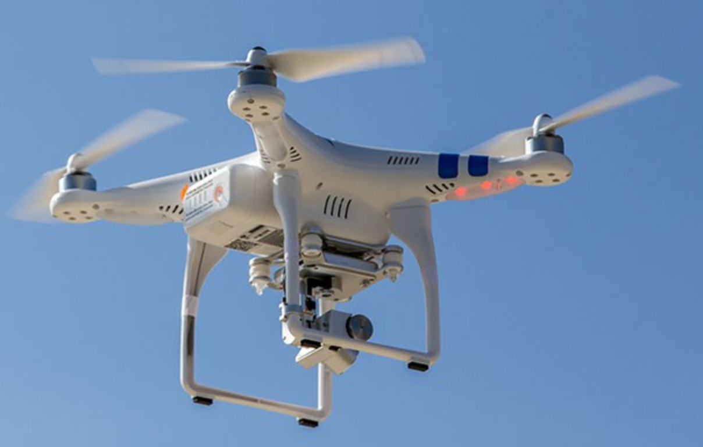
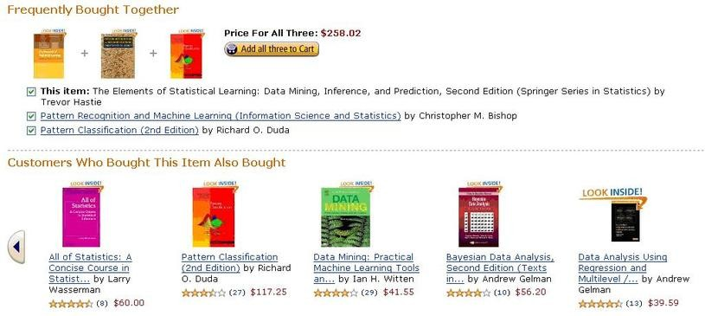
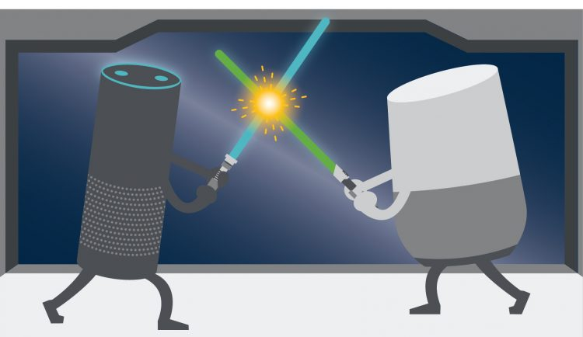
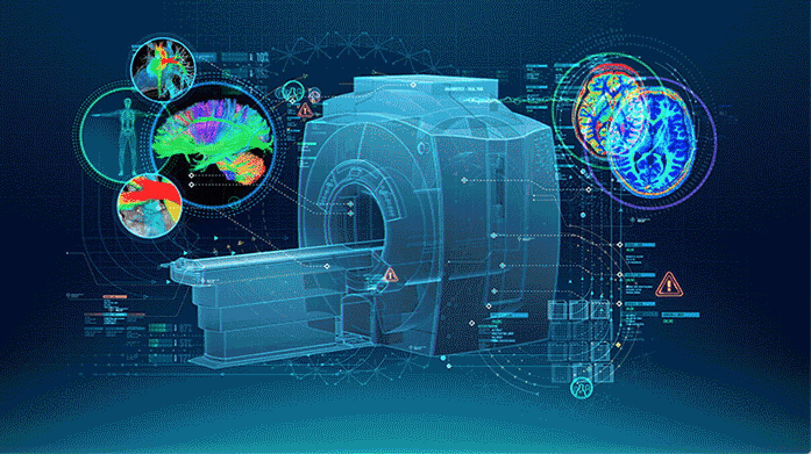
What deep learning can do
Natural Language Processing
Image Processing
Playing Games
Autonomous Driving
Recommendation System
Virtual Assistants
Health Care

Slide 3
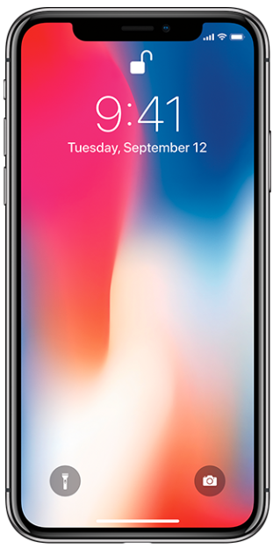
Challenges
Why Deep Learning?
Deep learning
Most learning algorithms
?
But Labels are scarce
High volume of data
Immense computational power
DNNs
or
or
✚
✚
DNNs

Slide 4
This talk
Part I: Information Maximization Auto-Encoding
1. An Information theoretical approach for learning a hybrid discrete and continuous representations in an unsupervised setting
2. A principled framework for understanding the tradeoffs regarding the informativeness of each representation factor, disentanglement, and decoding quality.
Part II: Simultaneous Parameter Tying and Sparsification in Deep Learning
1. A framework for simultaneous sparsification and correlation identification
2. A step towards understanding the intrinsic correlations in DNNs

Slide 5
Information Maximization Auto-Encoding

Slide 6
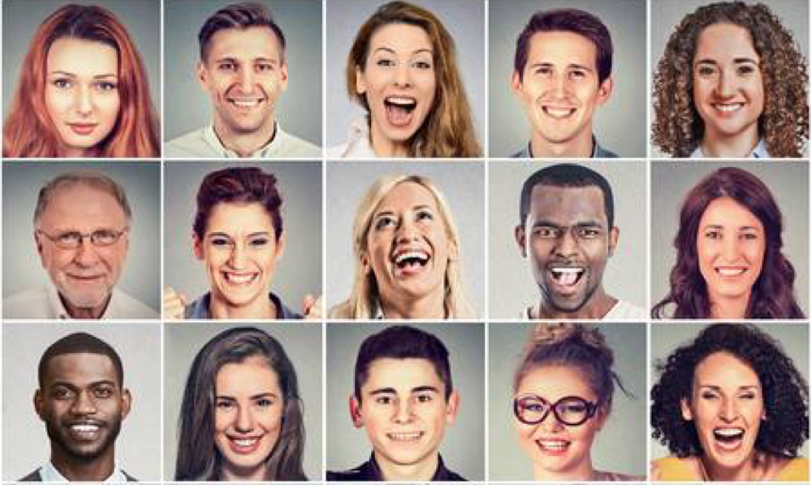
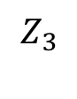
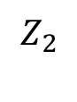
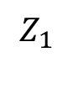
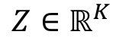
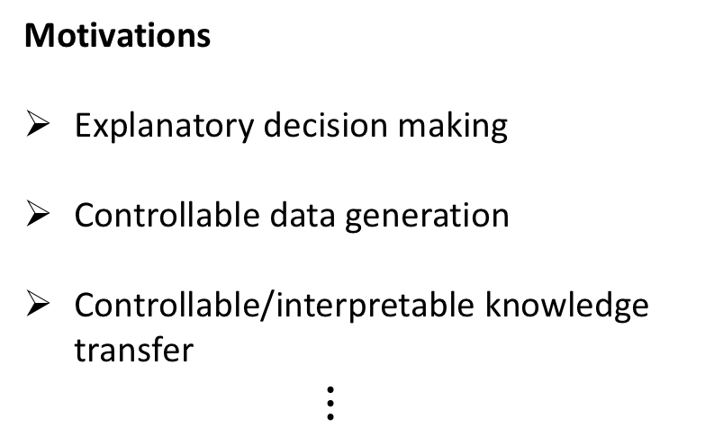

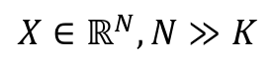
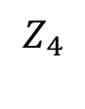
Learning disentangled representations
$$Z∈ℝ^{K}$$
$$Z_{1}$$
$$Z_{2}$$
$$Z_{3}$$
$$Z_{4}$$
$$⋯$$
Motivations
Explanatory decision making
Controllable data generation
Controllable/interpretable knowledge
transfer
$⋮$
gender
hair color
pose
expression
Complex (stochastic) process
Representation learning
$$X∈ℝ^{N}, N≫K$$

Slide 7
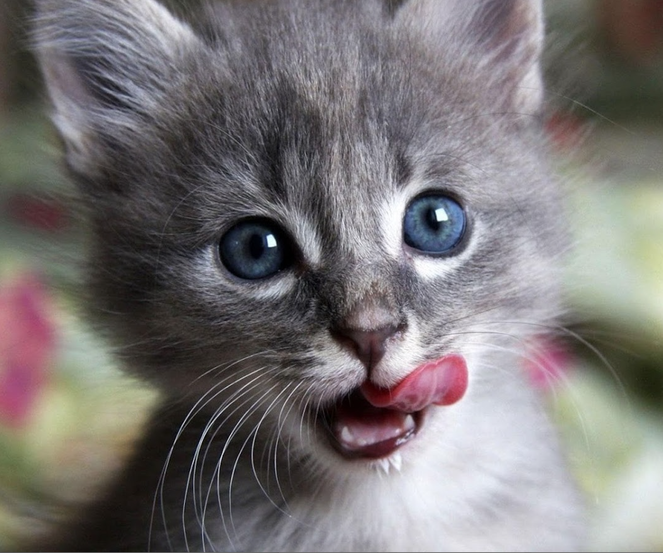
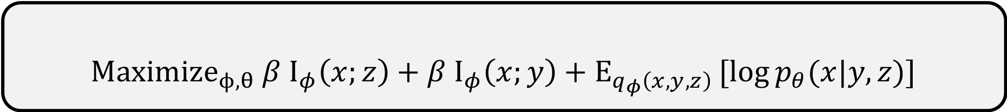
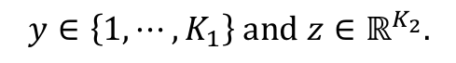

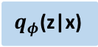
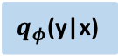

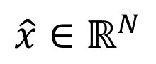
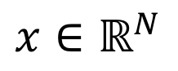

Learning a hybrid discrete and continuous representations
?
$q_{φ}$(y|x)
_{0.1 dog}
_{0.8 cat}
$$q_{φ}$$
_{0.1 fox}
$$p_{θ}$$
color
$$x∈ℝ^{N}$$
pose
$$\hat{x}∈ℝ^{N}$$
eye
$q_{φ}$(z|x)
$$y∈\left\{1, ⋯, K_{1}\right\} and z∈ℝ^{K_{2}}.$$
$$Maximize_{ϕ,θ} β I_{φ}\left(x;z\right)+β I_{φ}\left(x;y\right)+E_{q_{φ}\left(x,y,z\right)}[log{p_{θ}(x|y,z)]}$$
Intuition: interpretable representations should be informative about the data.
$$Maximize_{ϕ,θ} E_{q_{φ}\left(x,y,z\right)}[log{p_{θ}(x|y,z)]}$$

Slide 8
IMAE (Information Maximization Auto-Encoding)
$$Maximize_{ϕ,θ} β I_{φ}\left(x;y\right)+β I_{φ}\left(x;z\right)+𝔼_{q_{φ}\left(x,y,z\right)}[log{p_{θ}(x|y,z)]}$$

Slide 9
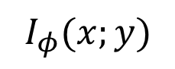
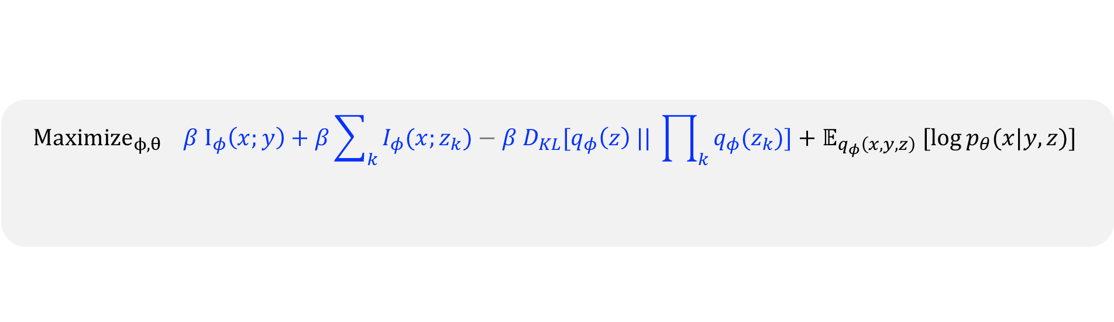
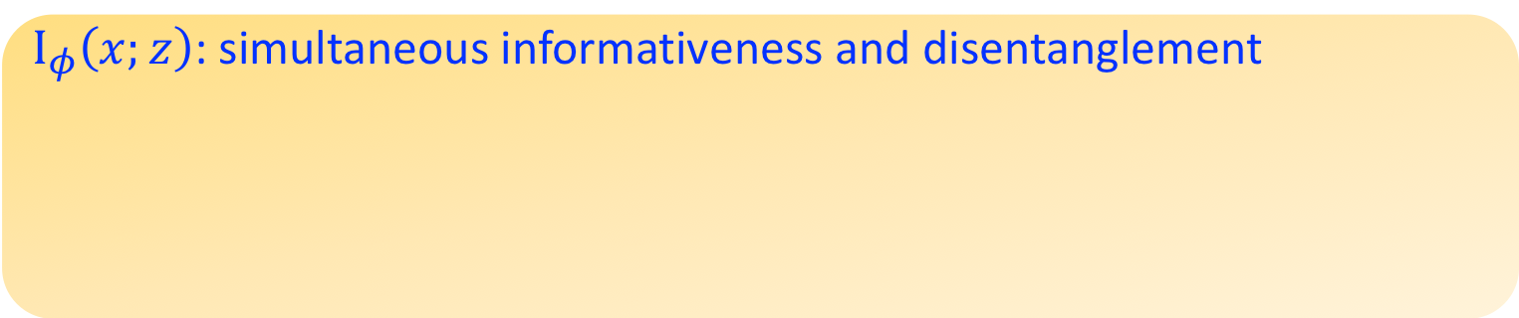
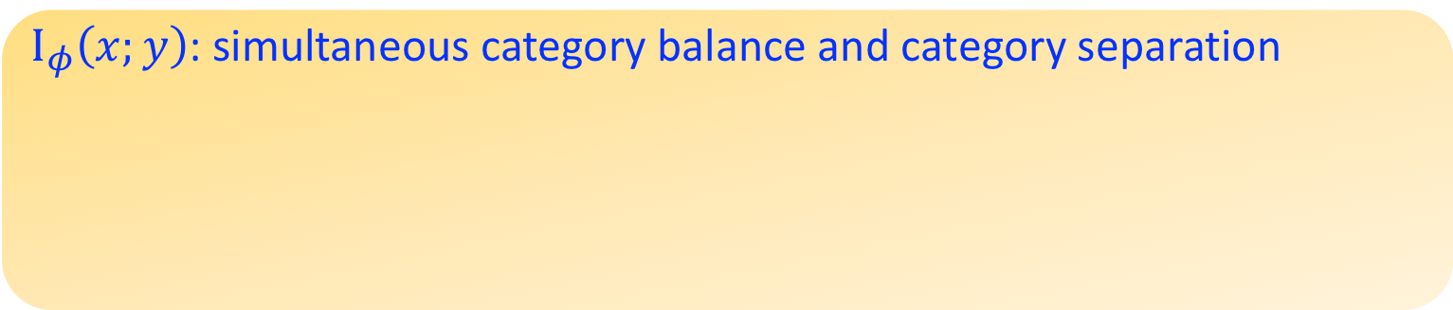
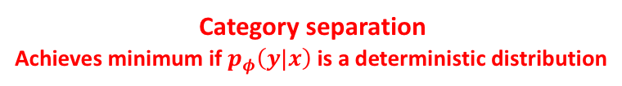
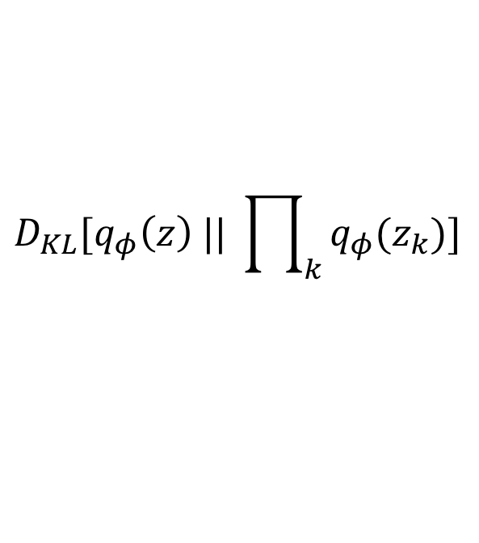
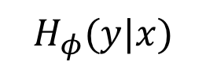
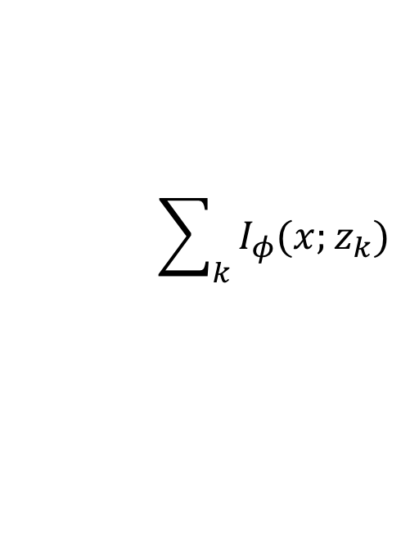
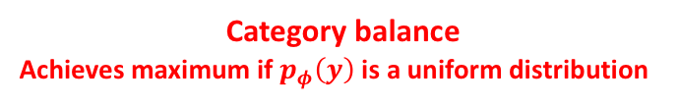
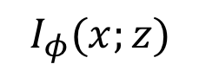
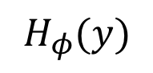
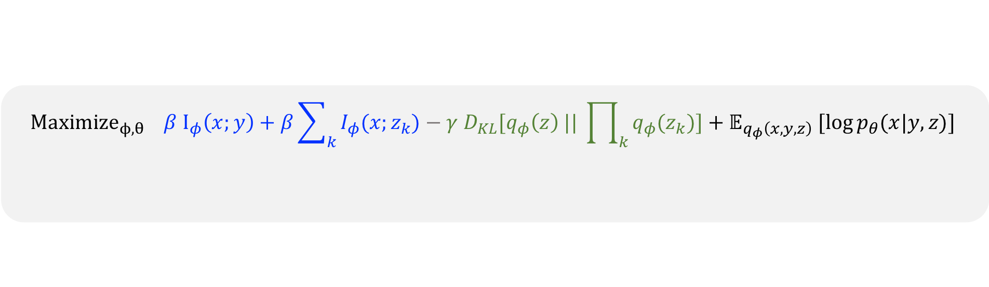
Informativeness yields interpretability
$$Maximize_{ϕ,θ} β I_{φ}\left(x;y\right)+β\sum_{k}{I_{φ}(x;z_{k})}−{γ D}_{KL}[q_{φ}\left(z\right) || \prod_{k}{q_{φ}(z_{k})]{+ 𝔼}_{q_{φ}\left(x,y,z\right)}[log{p_{θ}(x|y,z)]}}$$
$$Maximize_{ϕ,θ} β I_{φ}\left(x;y\right)+β\sum_{k}{I_{φ}(x;z_{k})}−{β D}_{KL}[q_{φ}\left(z\right) || \prod_{k}{q_{φ}(z_{k})]{+ 𝔼}_{q_{φ}\left(x,y,z\right)}[log{p_{θ}(x|y,z)]}}$$
$$Maximize_{ϕ,θ} β I_{φ}\left(x;y\right)+β I_{φ}\left(x;z\right)+𝔼_{q_{φ}\left(x,y,z\right)}[log{p_{θ}(x|y,z)]}$$
Informativeness of each representation factor
Decoding quality
Informativeness of each representation factor
Disentanglement
Decoding quality
Disentanglement
$I_{φ}\left(x;y\right)$: simultaneous category balance and category separation
-
$$I_{φ}(x;y)$$
=
$$H_{φ}(y)$$
$$H_{φ}(y|x)$$
Category balance
Achieves maximum if $p_{φ}\left(y\right)$is a uniform distribution
Category separation
Achieves minimum if $p_{φ}\left(y|x\right)$is a deterministic distribution
$I_{φ}\left(x;z\right)$: simultaneous informativeness and disentanglement
-
=
$$\sum_{k}{I_{φ}(x;z_{k})}$$
$$D_{KL}[q_{φ}\left(z\right) || \prod_{k}{q_{φ}(z_{k})]}$$
$$I_{φ}(x;z)$$
Informativeness of each dim
Independence across dims (total correlation)

Slide 10
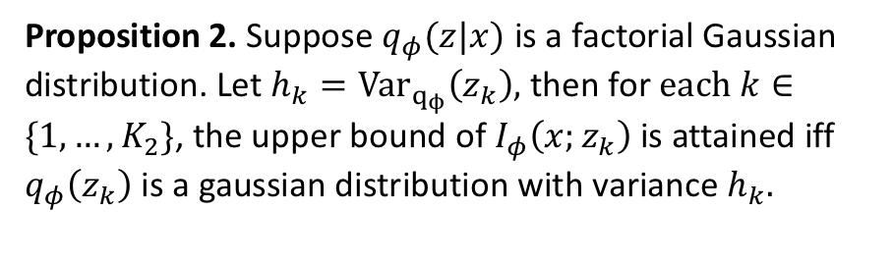
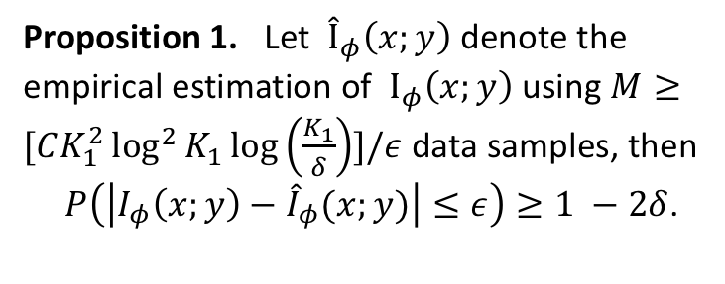
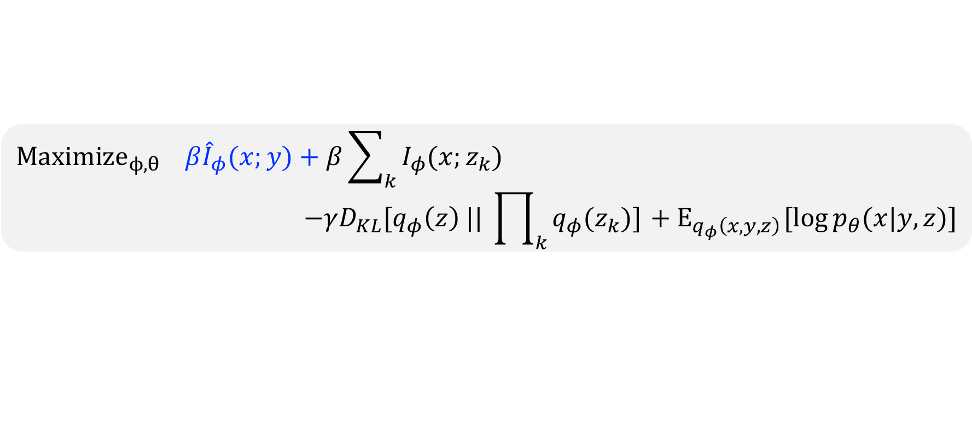
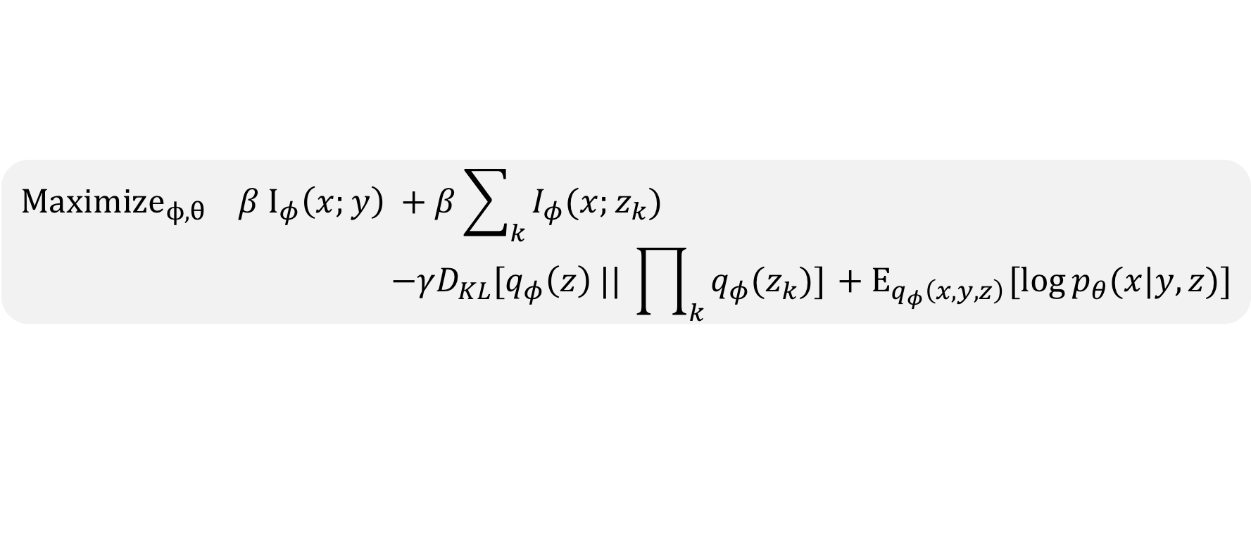
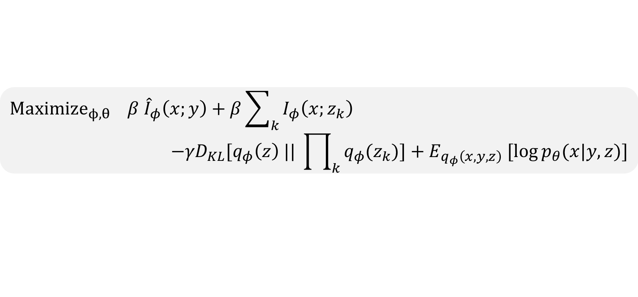
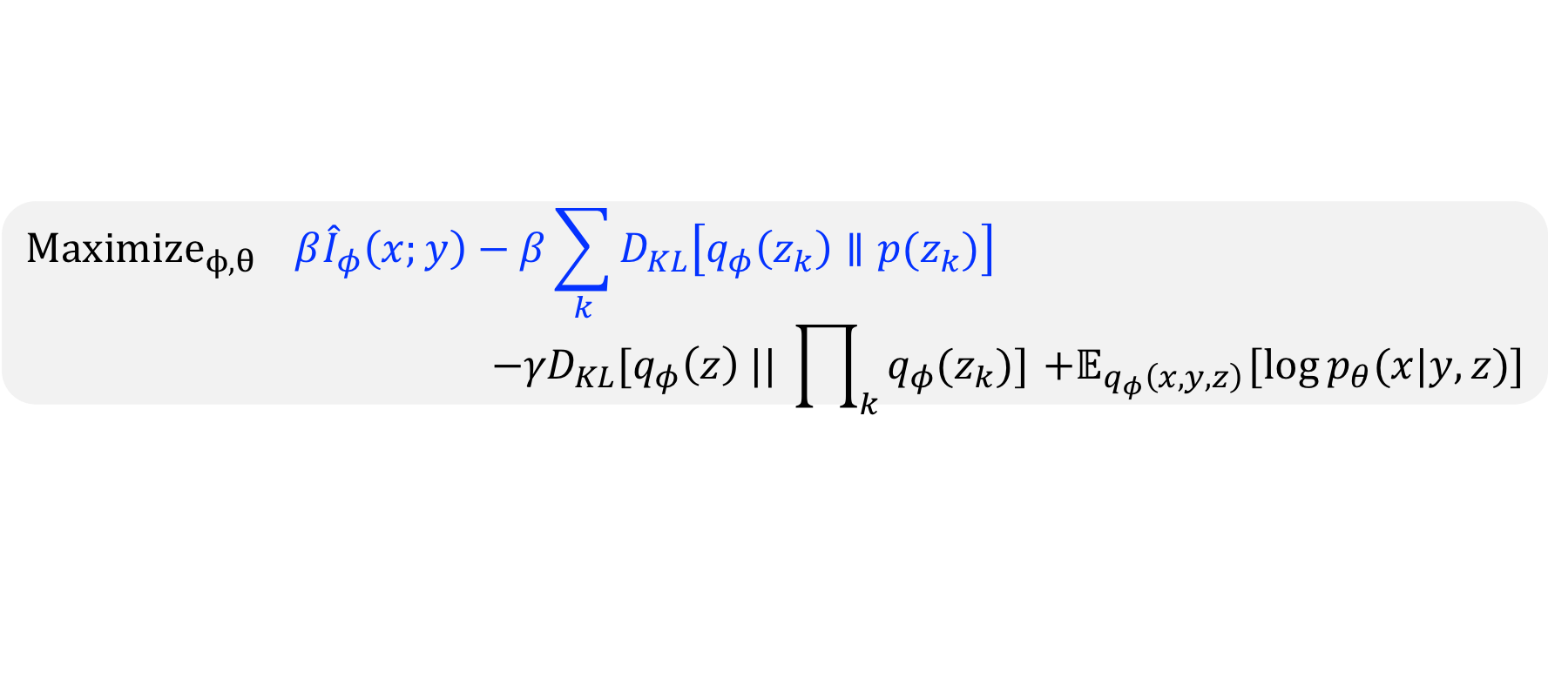
Optimizing the objective
$$Maximize_{ϕ,θ} β{\hat{I}}_{φ}\left(x;y\right)−β\sum_{k}{D_{KL}\left[q_{φ}\left(z_{k}\right)∥p(z_{k})\right]}$$
$$−{γD}_{KL}[q_{φ}\left(z\right) || \prod_{k}{q_{φ}(z_{k})]}{ +𝔼}_{q_{φ}\left(x,y,z\right)}[log{p_{θ}(x|y,z)]}$$
$$Maximize_{ϕ,θ} β{\hat{I}}_{φ}(x;y)+β\sum_{k}{I_{φ}(x;z_{k})}$$
$$−{γD}_{KL}[q_{φ}\left(z\right) || \prod_{k}{q_{φ}(z_{k})]}{ + E}_{q_{φ}\left(x,y,z\right)}[log{p_{θ}(x|y,z)]}$$
$$Maximize_{ϕ,θ} β I_{φ}\left(x;y\right) +β\sum_{k}{I_{φ}(x;z_{k})}$$
$$−{γD}_{KL}[q_{φ}\left(z\right) || \prod_{k}{q_{φ}(z_{k})]}{ + E}_{q_{φ}\left(x,y,z\right)}[log{p_{θ}(x|y,z)]}$$
$$p\left(z_{k}\right) are i.i.d scaled normal distribution$$
$$Maximize_{ϕ,θ} β {\hat{I}}_{φ}\left(x;y\right)+β\sum_{k}{I_{φ}\left(x;z_{k}\right)}$$
$$−{γD}_{KL}[q_{φ}\left(z\right) || \prod_{k}{q_{φ}(z_{k})]}{+ E}_{q_{φ}\left(x,y,z\right)}[log{p_{θ}(x|y,z)]}$$
Proposition 1. Let ${\hat{I}}_{φ}\left(x;y\right)$denote the empirical estimation of $I_{φ}\left(x;y\right)$ using $M≥[CK_{1}^{2}\log^{2}{K_{1}}\log\left(\frac{K_{1}}{δ}\right)]/ε$ data samples, then
$P\left(\left|I_{φ}\left(x;y\right)−{\hat{I}}_{φ}(x;y)\right|≤ε\right)≥1 −2δ$.
Proposition 2. Suppose $q_{φ}(z|x)$ is a factorial Gaussian distribution. Let $h_{k}=Var_{q_{ϕ}}\left(z_{k}\right),$ then for $each k∈\{1,…,K_{2}\}$, the upper bound of $I_{φ}\left(x;z_{k}\right)$is attained iff $q_{φ}\left(z_{k}\right)$ is a gaussian distribution with variance $h_{k}.$

Slide 11
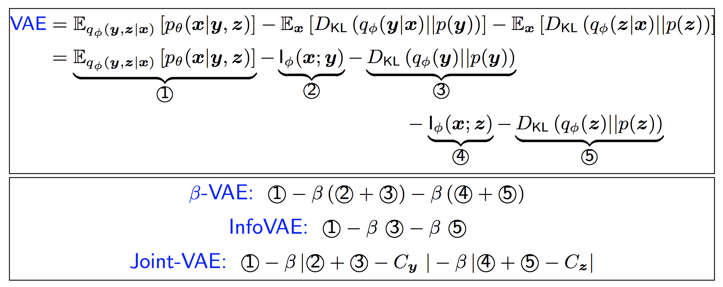
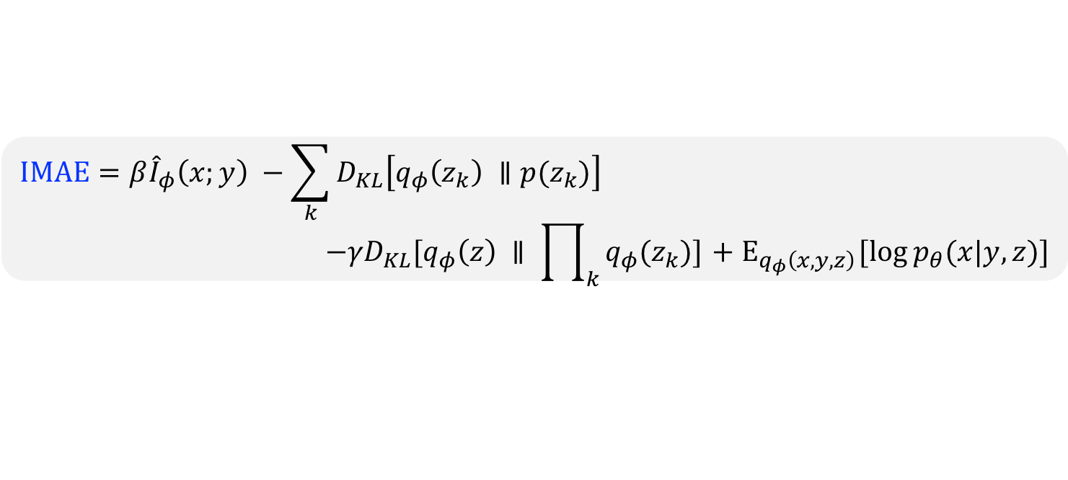
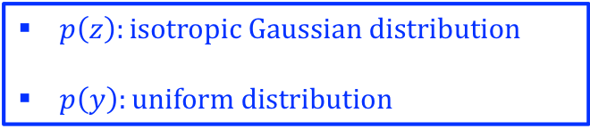
Related work
$$IMAE=β{\hat{I}}_{φ}\left(x;y\right) −\sum_{k}{D_{KL}\left[q_{φ}\left(z_{k}\right) ∥p(z_{k})\right]}$$
$$−{γD}_{KL}[q_{φ}\left(z\right) ∥ \prod_{k}{q_{φ}(z_{k})]}{ + E}_{q_{φ}\left(x,y,z\right)}[log{p_{θ}(x|y,z)]}$$
VS.
$p\left(z\right):isotropic Gaussian distribution$
$p\left(y\right):uniform distribution$
[1] VAE (Kingma&Welling, 2014) [2] $β$-VAE (Higgins et al., 2017) [3] $Info$-VAE (Zhao et al., 2017) [4] $Joint$-VAE (Doupont 2018))

Slide 12
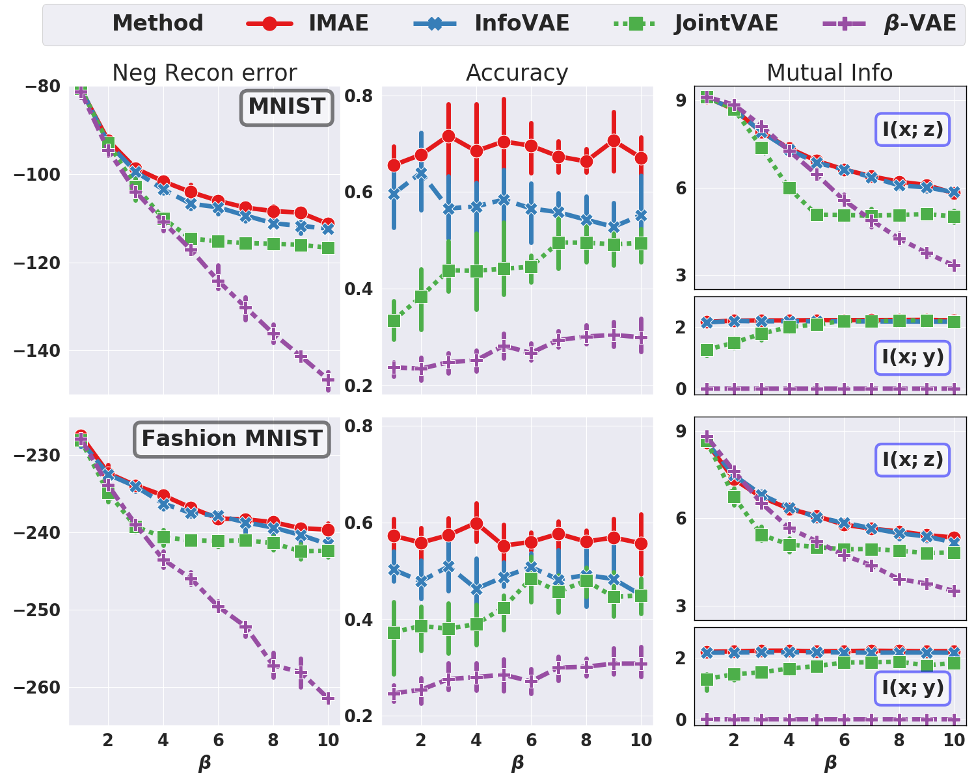
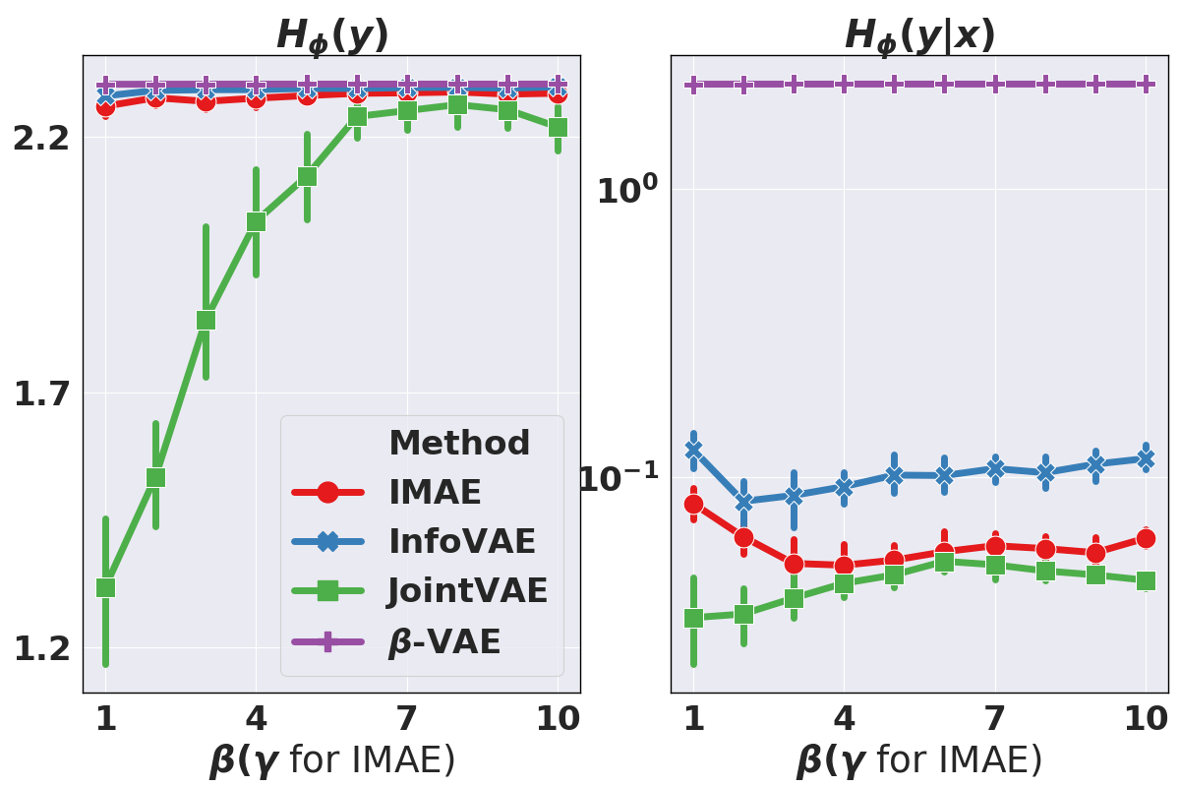
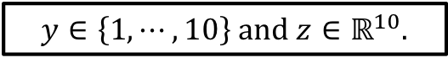

Quantitative comparison on (Fashion) MNIST
$$y∈\left\{1, ⋯,10\right\} and z∈ℝ^{10}.$$
Different models achieves different trade-offs between category balance $H(Y)$ and category separation $H\left(Y | X\right)$.
Evaluating different models by sweeping over $β (γ for IMAE)$ values.

Slide 13











Qualitative comparison on (Fashion) MNIST
Traverse z_{k}
Traverse y
I(x; y) = 2.3
I(x; y) = 0.0
I(x; z₃) = 1.8
I(x; z₅) = 1.6
I(x; z₆) = 1.0
I(x; z₈) = 0.0
I(x; z₆) = 1.7
I_{ɸ}(x; y) = 2.3
I(x; y) = 0.0
I(x; z₁) = 2.2
I(x; z₇) = 2.0
I(x; z₂) = 1.4
I(x; z₉) = 0.0
I(x; z₈) = 2.2
(a) IMAE
(b) $β$-VAE
We first randomly sample two isotropic gaussian random vectors for MNIST and Fashion MNIST correspondingly, then we traverse $z_{k}$ within range [-2.5, 2.5] in each row (with y fixed) and $y∈\left\{1,2, …, 10\right\}$ in each column (with z fixed)

Slide 14



dSprites
Latent factors
Y: square, ellipse, heart
Z: scale, orientation, position x-axis, position y-axis
We set $z∈ℝ^{10} \& y∈\left\{1,2,3\right\}$ for all four models.
Disentanglement metric (Tianqi Chen et al., 2018)
$MIG=\frac{1}{K}\sum_{k=1}^{K}{\frac{1}{H\left(v_{k}\right)}}\left(I\left(\overline{z_{j^{(k)}}}; v_{k}\right) −\max_{j≠j^{(k)}}{I\left(\overline{z_{j}}; v_{k}\right)}\right)$ where $j^{\left(k\right)}=argmax_{j} I\left(\overline{z_{j}};{ v}_{k}\right)$
Here $v_{k}$denotes the $k$-th true factor and $\overline{z_{j}}∈\left\{y,z_{1},z_{2},⋯,z_{K_{2} }\right\}.$
0.01 | 2.20 | 0.05 | 0.21 | 0.00
$V_{1}:$ scale
$$Y Z_{1} { Z}_{2} Z_{3} { Z}_{4}$$

Slide 15

Quantitative evaluation on dSprites
The results are reported over 20 random initializations. Shade regions indicate 90% confidence interval.

Slide 16























Quantitative evaluation on dSprites
Traverse $z_{k}$
Traverse $z_{k}$
$z_{2}:$ rotation
$z_{1}$: x-axis
$z_{4}:$ y-axis + scale
$z_{5}$: scale
$z_{5}$: rotation + scale
$z_{8}$: rotation
$z_{7}$: y-axis + scale
$z_{9}$: y-axis
$z_{8}$: shape + rotation
(b) Disentanglement score = 0.44
(a) Disentanglement score = 0.09
Traverse $z_{rotation}$
Traverse $z_{scale}$
Traverse $z_{position}$
Traverse y
$I(y, shape)$ = 0.54
$I(y, rotate)$ = 0.68
$I(y, shape)$ = 0.13
$I(y, rotation)$ = 0.47
$I(y, shape)$ = 0.01
$I(y, scale)$ = 0.68

Slide 17






Evaluating IMAE on CelebA
Traverse $z_{k}$
Some of the uncovered continuous factors
Gender
Azimuth
Background Color
Hair Color
Less interpretable discrete representations when the underlying categorical information is not prominent
Traverse y

Slide 18

Future directions
Explicitly encouraging independence between continuous and discrete representations
Independent scalar latent factors group independence
Learning more interpretable discrete representation by augmenting $I_{φ}(x;y)$ with proper regularization

Slide 19
Learning to share:
simultaneous parameter tying and sparsification in deep learning

Slide 20
Neural network compression
Cheap storage
Faster Inference
Fewer degrees of freedom
Better Interpretability
More robustness

Slide 21






Simultaneous sparsification and parameter tying
$$h_{l}$$
$$h_{l−1}$$
$$h_{l}$$
$$h_{l−1}$$
$$f_{l}\left(h_{l−1}^{T}\left[\begin{matrix}\begin{aligned}0 \\ 0.62 \\ 0.99\end{aligned} & \begin{aligned}0 \\ 0.75 \\ −0.46\end{aligned} & \begin{aligned}0 \\ 0.49 \\ 0.29\end{aligned} \\ 0 & 0 & 0 \\ 0.62 & 0.75 & 0.49\end{matrix}\right]\right)=h_{l}$$
$$f_{l}\left(h_{l−1}^{T}\left[\begin{matrix}\begin{aligned}0 \\ −0.88 \\ 0.99\end{aligned} & \begin{aligned}0 \\ 0.97 \\ −0.46\end{aligned} & \begin{aligned}0 \\ 0.37 \\ 0.29\end{aligned} \\ 0 & 0 & 0 \\ 1.88 & 0.45 & 0.65\end{matrix}\right]\right)=h_{l}$$
Eliminating unimportant neurons
Simultaneously identifying strongly correlated neurons by tying the associated weights (rows) to a common /close value(s)
Denoise
Copes with co-adaption
Better interpretability

Slide 22










GrOWL regularization for deep learning
GrOWL (group ordered $l_{1}$regularization). Given a matrix $W∈ℝ^{n×m }$, let $w_{\left[i\right]⋅}$ denote the row of $W$ with the $i$–th largest $l_{2}$norm. Let $λ_{1}≥λ_{2}≥⋯≥λ_{n}≥0 with λ_{1}>0.$ Then GrOWL is defined as:
$$Ω_{λ}\left(W\right)= \sum_{i=1}^{n}{λ_{i}{\left\|w_{\left[i\right]⋅}\right\|}_{2}}$$
Layerwise GrOWL Regularization. Let $ℒ$ denote the loss incurred by a DNN, $N_{l}$ the # neurons in the $l$-th layer, and $W_{l}$ be the weight matrix.
$$\min_{θ} ℒ\left(θ\right)+{ ℛ\left(θ\right), where ℛ\left(θ\right)=\sum_{l=1}^{L}{Ω_{λ\left(l\right)}\left(W_{l}\right) with λ^{(λ)}∈ℝ_{+}^{N_{l−1}}}}.$$
layer $l−1$
$$layer l$$
layer $l−1$
$$layer l$$
layer $l−1$
$$layer l$$
GrOWL regularization effect on fully connected layer and convolutional layer.

Slide 23




Two-stage procedure
Cluster information
Enforce parameter sharing within clusters
DNN weights initialization
Training with GrOWL
Sparse DNN
Retraining
Parameter- shared
sparse DNN
Sparsity Inducing & parameter tying
Parameter Sharing
Phase I. Identifying the correlations only among top-p important neurons from the previous layer.
$$λ_{i}=\left\{\begin{aligned}Λ_{1}+\left(p−i+1\right)Λ_{2}, i≤p \\ Λ_{1}, i>p\end{aligned}\right.$$
$Λ_{1} controls the sparsifying strength$
$Λ_{2} controls the correlation identification ability$
Phase II. For each layer $l,$ we first group the rows of $W_{l}$ into different clusters according to the pairwise similarity metric
$$𝒮_{l}\left(i,j\right)= \frac{W_{l,i }^{T}W_{l,j}}{\max\left({\left\|W_{l,i }^{}\right\|}_{2}^{2},{\left\|W_{l,j }^{}\right\|}_{2}^{2}\right)}$$
Then we enforce parameter sharing for rows within each cluster by replacing their values with the centroid cluster.

Slide 24

Compression vs. Accuracy
Sparsity, parameter sharing, and compression rate on MNIST.

Slide 25
Uncovering the correlations in data
Data correlation and the correlation patterns identified by different regularizers.

Slide 26
Stable learning process
Sparsity pattern of the learned neural network over five runs. The mean ratio of changed indices are 11.09%, 0.59%, 32.07%, and 0.62% respectively.

Slide 27

DNNs tend to maintain diversity in the bottom layers
Sparsity (S1) and parameter sharing (S2) of VGG-16 on CIFAR-10.

Slide 28
DNNs tend to maintain diversity in the bottom layers
Output channel cosine similarity histogram. Labels: GO (GrOWL), GOL (GrOWL + $l_{2}),\text{G}\text{L} \text{(}\text{group}\text{−}\text{Lasso}\text{), }\text{G}\text{L}\text{L} (\text{group}\text{−}\text{Lasso}+l_{2}),$ WD: weight decay

Slide 29
Future directions
Applying GrOWL on more complex datasets and larger neural networks.
Improving diversity vs sharing trade-off by encouraging sharing among smaller units.
Exploring how GrOWL can improve the adversarial robustness of DNNs.

Slide 30
Reference
Dejiao Zhang, Tianchen Zhao, Laura Balzano. Information Maximization AutoEncoding. BDL, NeurIPS 2018. (long version submitted to ICML 2019).
Dejiao Zhang, Yitong Sun. On information maximization and overfitting trade-off in deep generative models. In preparation.
Dejiao Zhang, Haozhu Wang, Mario Figueiredo, Laura Balzano. Learning to share: simultaneously parameter tying and sparsification in deep learning. ICLR 2018.
Thank you!

